Slide 1
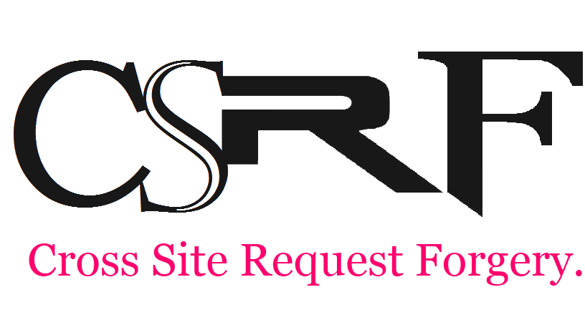
Type of malicious exploit of a website where unauthorized commands are transmitted from a user that the web application trusts.

Slide 2
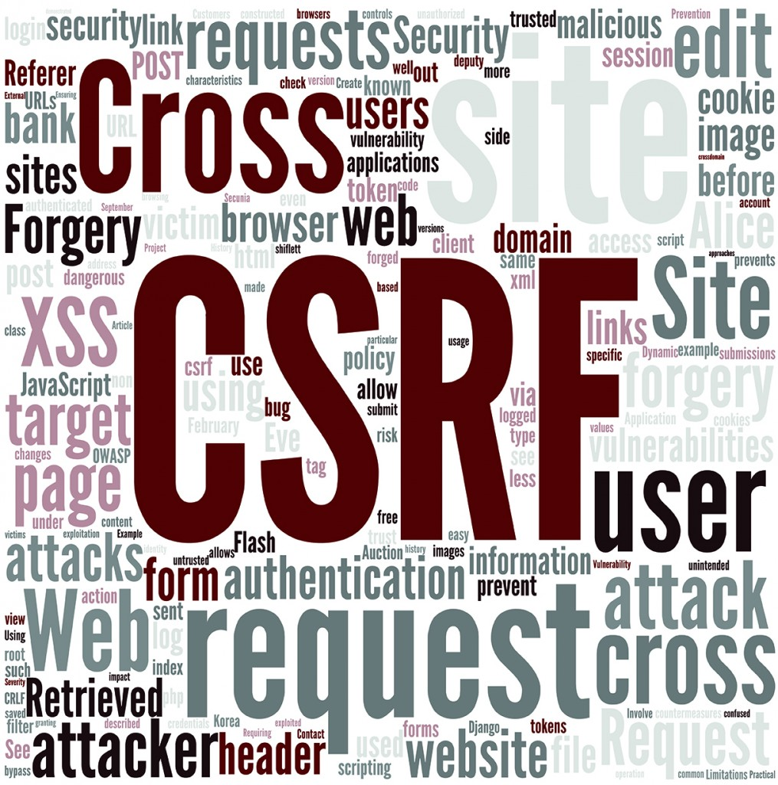
CSRF is also known as one-click attack
It have been known since 2001.
Some website logs might not have evidence of CSRF.
Because it is carried out from the user’s IP address, some website logs might not have evidence of CSRF
The attack exploits the trust a website has for a user’s browser.

Slide 3
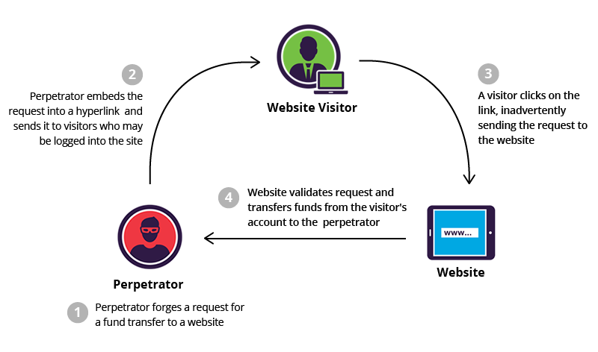
How it works?

Slide 4

Prevent CSRF:
Synchronizer Token Pattern
Challenge-Response
Checking The Referer
Checking The Origin Header
XYZcom

Slide 5
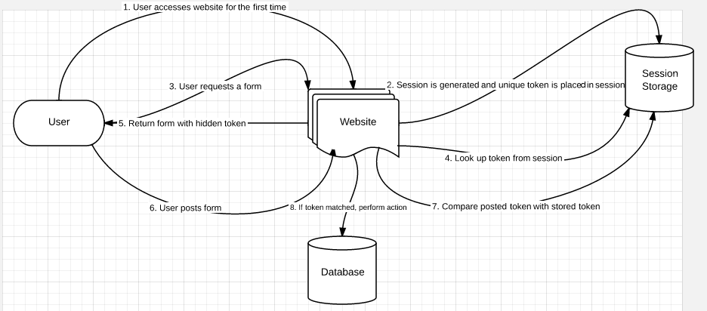
Synchronizer Token Pattern

Slide 6
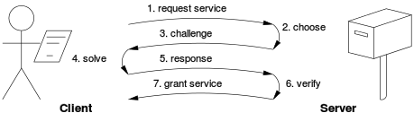
Challenge-Response

Slide 7
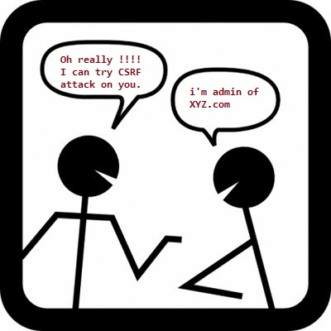
XYZ.com
XYZ is a technology company that provides domain names and related services to indiviruals and buinesses worldwide. Using AntiForgery Token validation for all the POST calls in xyz.com. Registered xyz.com users get email alerts for the contents they are signed up for.

